Slide 1
Principles of Economics
Lecture 3

Slide 2
Macroeconomic Instability
Economic Growth
Business Cycle
Unemployment
Inflation

Slide 3
Economic Growth
Economists define and measure economic growth as either:
An increase in real GDP occurring over some time period
or
An increase in real GDP per capita occurring over some time period.

Slide 4
Economic Growth
Rate of growth=[(real GDP current year-real GDP last year)/real GDP last year]×100
If real GDP was $ 200 billion in some country last year and $ 210 billion this year, the rate of growth would be 5 percent.
Rule of 70:
Approximate number of years required to double real GDP = (70 / annual percentage rate of growth)

Slide 5
The Business Cycle
The term business cycle refers to alternating rises and declines in the level of economic activity.
Most often, rise and decline of economic activity is represented by “real GDP”
Decline in real GDP leads to significant increases in unemployment.
Rapid economic growth has been marred by rapid inflation.

Slide 6
The Business Cycle
The term business cycle refers to alternating rises and declines in the level of economic activity.
Decline in real GDP leads to significant increases in unemployment.
Rapid economic growth has been marred by rapid inflation.

Slide 7
The Business Cycle
Growth Trend
Level of real output
Peak
Recovery
Recession
Trough
Time

Slide 8
Phases of the Business Cycle
Peak:
→ at a peak business activity has reached a temporary maximum.
→ the economy is at full employment.
→ very close to full productivity.
The price level is likely to rise during this phase. (rapid inflation)

Slide 9
Phases of the Business Cycle
Recession:
→ a period of decline in total output, income, employment, and trade.
→ wide spread contraction of business activity.
The price level is likely to fall.

Slide 10
Phases of the Business Cycle
Trough:
→ output and employment bottom out at their lowest levels.
→ the trough phase may be either short lived or quite long.

Slide 11
Phases of the Business Cycle
Recovery:
→ in the recovery phase, output and employment rise toward full employment.
The price level may begin to rise before full employment and full capacity production return.

Slide 12
Unemployment
“adult population” (16 years or older)
  Employed: paid employees, self-employed,
  and unpaid workers in a family business
  Unemployed: people who were available and not working but who have looked for work during previous 4 weeks
  Not in the labor force: those who do not fit either any of the above two categories. i.e. full-time student, homemaker, or retiree
The labor force is the total # of workers, including the employed and unemployed.

Slide 13
Unemployment
Both those who are employed and those who are unemployed but actively seeking work are counted as being in the labor force.

Slide 14
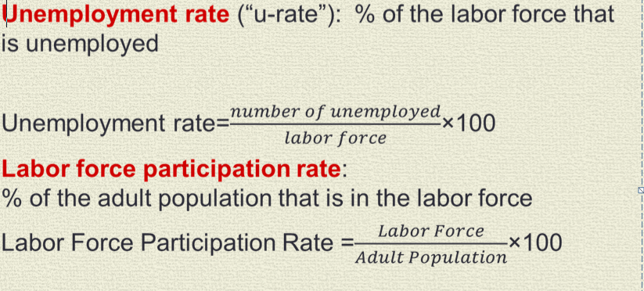
Unemployment
The unemployment rate is the percentage of the labor force unemployed:
Unemployment rate= (unemployed / labor force) X 100

Slide 15
Types of Unemployment
There are three types of unemployment:
→ Frictional Unemployment
→ Structural Unemployment
→ Cyclical Unemployment

Slide 16
Frictional Unemployment
  Frictional unemployment occurs when workers spend time searching for the jobs that best suit their skills and tastes
So, Frictional unemployment consisting of search unemployment and wait unemployment.
  short-term for most workers

Slide 17
Structural Unemployment
Structural unemployment results because the composition of the labor force does not respond immediately or completely to the new structure of job opportunities.
Structurally unemployed workers find it hard to obtain new jobs without retraining, gaining additional education, or relocating.

Slide 18
The sum of frictional and structural unemployment is called natural unemployment or full employment
This unemployment will always remain in the country.
Natural unemployment rate is the normal rate of unemployment around which the actual unemployment rate fluctuates.

Slide 19
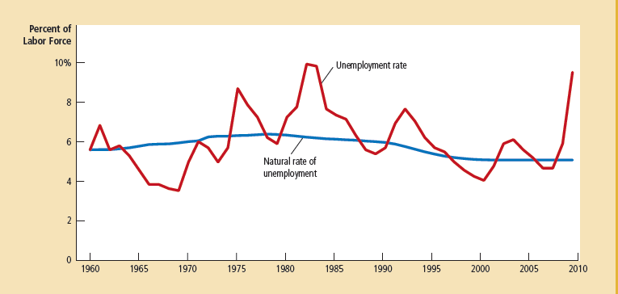

Slide 20
Cyclical Unemployment
Cyclical unemployment is caused by a decline in total spending and is likely to occur in the recession phase of the business cycle.
  It is measured as the deviation of total unemployment rate from
  natural rate of unemployment

Slide 21
Unemployment, GDP and Okun’s Law
The negative relationship between unemployment and real GDP is called the Okun’s Law.
Percentage change in real GDP = 3% - 2 * change in the unemployment rate

Slide 22
Inflation and inflation rate
Inflation refers to a situation in which the economy’s overall price level is rising.
The inflation rate is the percentage change in the price level from the previous period.

Slide 23
Types of Inflation
Two types of inflation:
→ Demand-Pull Inflation
→ Cost-Push Inflation

Slide 24
Demand-Pull & Cost-Push Inflation
Demand Pull Inflation: Changes in the price level are caused by an excess of total spending beyond the economy’s capacity to produce.
Cost-Push Inflation: Rising prices in terms of factors that raise per-unit production cost at each level of spending.

Slide 25
Is inflation always bad for economy?
  Not all prices rise at the same rate during inflation.
  Not everyone suffers equally from inflation.
  Although inflation makes some people worse off, it makes some people better off
Hyperinflation is an extraordinarily high rate of inflation such as Germany experienced in the 1920s.
Hyperinflation is inflation that exceeds 50% per month

Slide 26
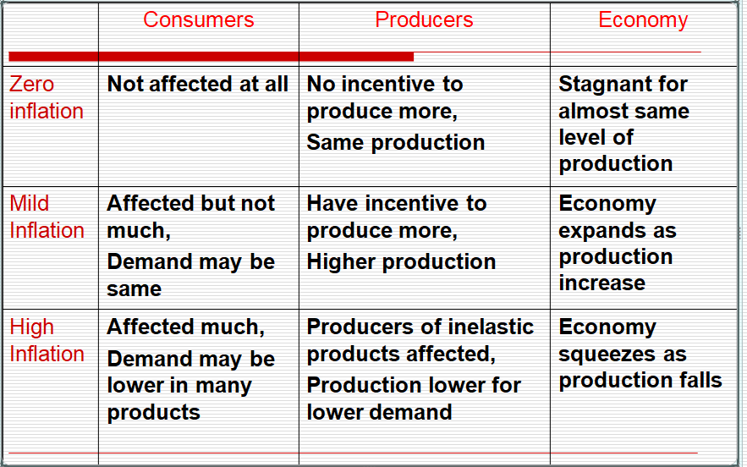
The effects of inflation

